Slide 1
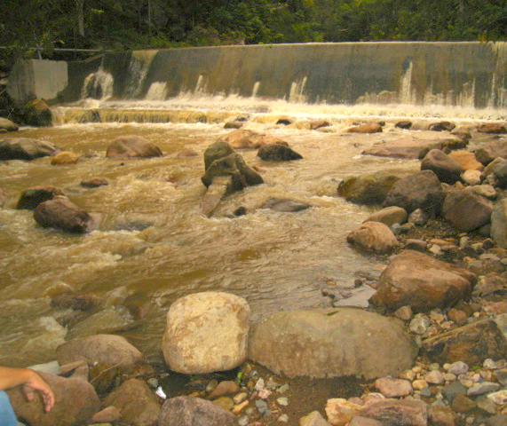
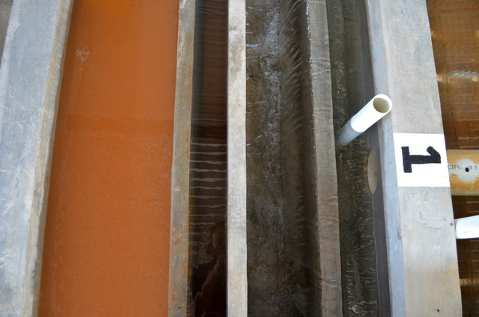
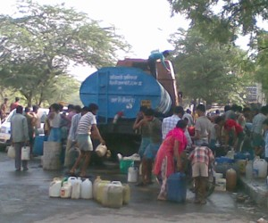
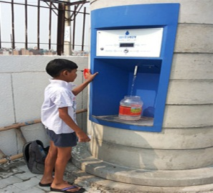
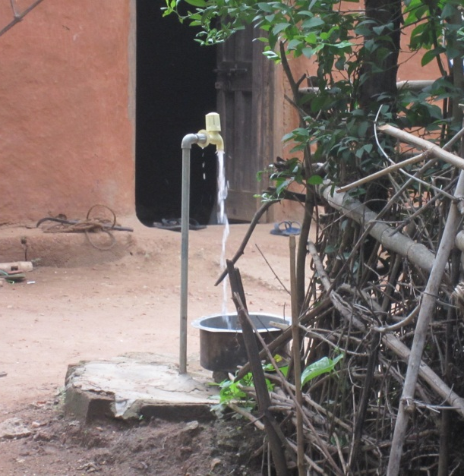
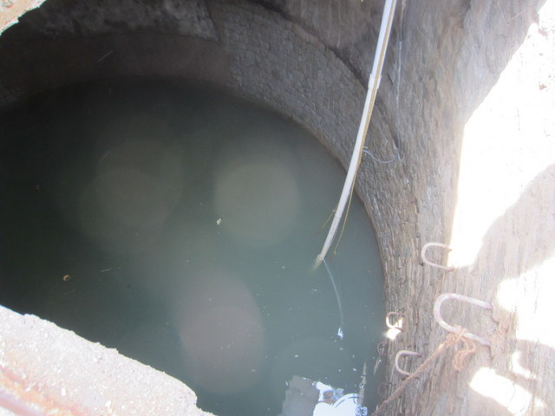
Drinking Water Contaminants

Slide 2
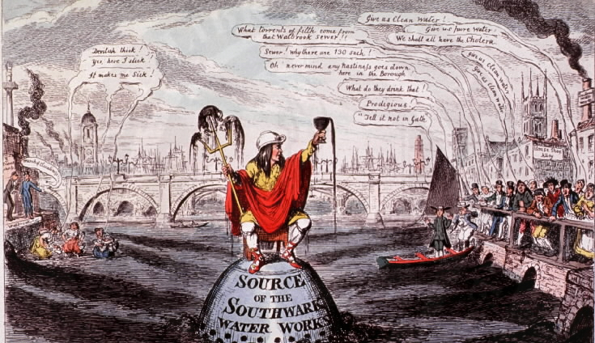

Overview
History of our understanding of waterborne disease
Drinking Water Standards: how do we decide what is allowed in the water we drink?

Slide 3
Drinking Water Treatment and Germ Theory
1829: First sand filter used to treat some of London's drinking water
1850: John Snow established the link between drinking water (from a contaminated well) and Cholera
1872: Poughkeepsie, NY installs first filter in US
1885: Sand filters are shown to remove bacteria
1892: Cholera outbreak in Hamburg, Germany

Slide 4
The flush toilet contaminates safe drinking water with feces
Toilets made cities habitable by carrying human waste “away”
Unfortunately “away” was too close…
In the early 1800s new flush toilets and sewers carried the waste directly into rivers and streams
Chicago!
London drained its raw sewage into and withdrew its drinking water from the Thames River, both without any treatment.
Several of the drinking water intakes were below sewage outfalls!

Slide 5
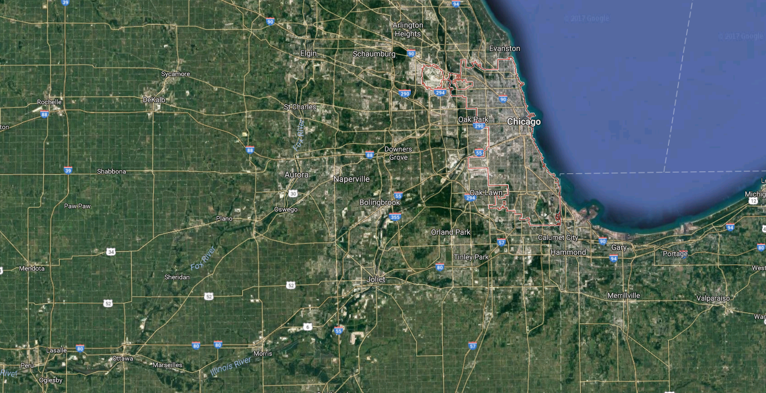
Chicago Sanitary and Ship Canal 1892: a creative solution

Slide 6
Southwark and Vauxhall Water Company
In 1850, the microbiologist Arthur Hassall wrote of the River Thames water they were using,"...a portion of the inhabitants of the metropolis are made to consume, in some form or another, a portion of their own excrement, and moreover, to pay for the privilege."
Next Cartoon presents John Edwards, owner of the Southwark Water Company, posing as Neptune ("Sovereign of the Scented Streams"). He is seen crowned with a chamber-pot, seated on a stool on top of a cesspool which doubles as the water-intake for the Southwark Water Company customers in south London.
Notes:
http://www.ph.ucla.edu/epi/snow/southwarkwatercompany.html (comments)

Slide 7
Southwark and Vauxhall Water Company
Courtesy of the National Library of Medicine
Notes:
http://wwwihm.nlm.nih.gov/ihm/images/A/24/183.jpg
Direct reuse without treatment

Slide 8
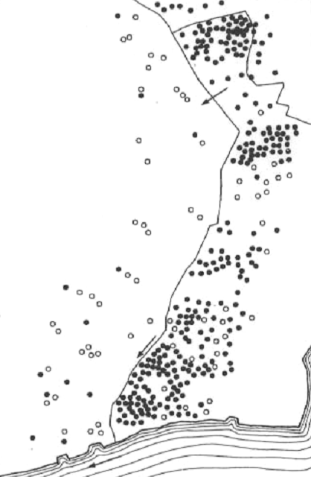
1892 Cholera outbreak in Hamburg Germany
Altona's water intake and filter beds
Hamburg
Altona
Hamburg's sewer outfalls
Hamburg's water intake
Elbe River
Large outbreak of Cholera in Hamburg
17,000 cases; 8,600 deaths
Very few cases in neighborhoods served by Altona's filtered water supply
Hamburg's sewers were upstream from Altona's intake!

Slide 9
Altona vs. Hamburg: Cholera Cases
Cholera cases
Cases in Altona acquired in Hamburg
Received water from Altona
Altona
Conclusions
Cholera was waterborne
Hamburg
Slow sand filtration may have protected Altona

Slide 10
Fecal-Oral Pathways
Hygiene
Water treatment
Sanitation
Pathogen source
Sanitation method
Environment
Transport
washing
Drinking water
Human excreta
Dry sanitation involving reuse
Hands
Surface water
Waterborne sewage
Water
Ground water
Oral
Non recycling latrines
Crops
Animal excreta
Food
Land application
Flies
Soil
Will you see an immediate improvement in public health with the installation of a water treatment plant?
Notes:
What technology that is commonly found in homes plays an important role in breaking the Fecal-Oral pathway? SINKS!

Slide 11
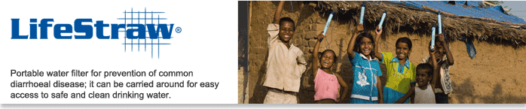
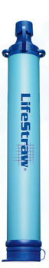
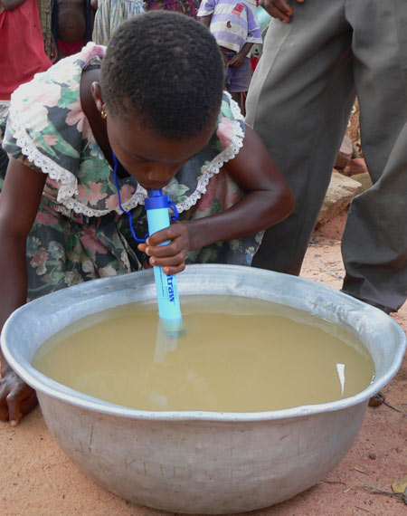
What are two fecal-oral pathways?
How will cap be removed?
Where does the mouth go?
What can you conclude based on mass conservation?

Slide 12
Overview
History of our understanding of waterborne disease
Drinking Water Standards: how do we decide what is allowed in the water we drink?

Slide 13
Waterborne Threats to Human Health
Infectious diseases
caused by viruses, bacteria, and protozoa (pathogens)
Bad bugs
Noninfectious diseases
_____: caused by short term exposure to harmful chemicals
_______: caused by long term exposure to harmful chemicals
low levels of exposure to certain chemicals over a long period of time may cause cancer, liver and kidney damage, or central nervous system damage
acute
chronic

Slide 14
Optimal Pathogen Exposure
Should we be exposed to small doses of pathogens so we build up our resistance?
How could we build pathogen exposure into our daily lives?
Potential application
Common cold (continues to mutate)
Norwalk virus (Immunity, however, is not permanent and re-infection can occur after 2 years)
HIV (no immunity)
Early exposure to germs has lasting benefits. Nature, March 2012
Immune systems of healthy adults 'remember' germs to which they’ve never been exposed, Stanford study Feb 2013
Notes:
Do you ask friends to cough on you?
“This cross-reactivity could explain why exposure to common bugs in the dirt and in our homes renders us less susceptible to dangerous infectious agents.” http://med.stanford.edu/news/all-news/2013/02/immune-systems-of-healthy-adults-remember-germs-to-which-theyve-never-been-exposed-stanford-study-finds.html

Slide 15
EPA: Safe Drinking Water Act (1974)
Specific standards for drinking water
primary (__________)
secondary (__________ upper limits for non-health related parameters)
Applicable to all water supplies serving more than 25 people or having 15 or more service connections
Enforced by U.S. Environmental Protection Agency
Global resource is the World Health Organization – Drinking Water Quality Guidelines
mandatory
suggested

Slide 16
Primary Standards: (Health) 6 Broad Categories
Microorganisms
Disinfectants
Disinfection Byproducts
Inorganic Chemicals
Organic Chemicals
Radionuclides
Where is “dirt”?

Slide 17
Primary Standards: (Health) Inorganic chemicals (units of mg/L)
Contaminant U.S. EPA
Antimony 0.006
Arsenic 0.01
Asbestos (fiber >10 micrometers) 7 MFL
Barium 2
Beryllium 0.004
Cadmium 0.005
Chromium (total) 0.1
Copper Action Level=1.3; TT⁸
Cyanide (as free cyanide) 0.2
Fluoride 4.0
Lead Action Level=0.015; TT⁸
Inorganic Mercury 0.002
Nitrate (measured as Nitrogen) 10
Nitrite (measured as Nitrogen) 1
Selenium 0.05
Thallium 0.002
Notes:
http://water.epa.gov/drink/contaminants/index.cfm
Also see WHO at http://www.who.int/water_sanitation_health/dwq/2edvol1c.pdf?ua=1

Slide 18
Primary Standards: (Health) A Few Organic Chemicals (units of mg/L) see the complete list!
Contaminant MCLG MCL
Acrylamide zero TT
Alachlor zero 0.002
Atrazine 0.003 0.003
Benzene zero 0.005
1-1-Dichloroethylene 0.007 0.007
Dioxin (2,3,7,8-TCDD) zero 0.00000003
Epichlorohydrin zero TT
Ethylbenzene 0.7 0.7
Ethelyne dibromide zero 0.00005
Lindane 0.0002 0.0002
Polychlorinated biphenyls (PCBs) zero 0.0005
Tetrachloroethylene zero 0.005
Toluene 1 1
Total Trihalomethanes (TTHMs) none⁵ 0.10
Trichloroethylene zero 0.005
Vinyl chloride zero 0.002
Xylenes (total) 10 10
Notice the many herbicides, pesticides, and consider what that means for agriculture runoff in countries where agricultural chemicals are poorly regulated

Slide 19
How can we remove contaminant x?
Course website (https://github.com/AguaClara/SWOT/wiki/Contaminant-Treatment)
EPA database on contaminants and treatment methods
Pick the contaminant from the very long list
Select Treatment Process

Slide 20
Primary Standards : (Health) Related to Microorganisms
Contaminant MCLG MCL
Cryptosporidium zero TT³
Giardia lamblia zero TT³
Legionella zero TT³
Viruses (enteric) zero TT³
Heterotrophic plate count N/A TT³
Total Coliforms zero 5.0%⁴
Turbidity N/A TT³
MCLG at zero because ingesting one protozoa, virus, or bacterium may cause adverse health effects
Treatment Technique specified when there isn’t an economical and technically feasible method to measure a contaminant
Cause disease
Indicators
Pathogens are particles

Slide 21
Turbidity
A measure of the scattering of light by particles in a suspension
A turbid water sample appears cloudy or “dirty”
High turbidity is the result of lots of light scattering caused by the particles in suspension
Measured in NTU (Nephelometric Turbidity Units)
cloud

Slide 22
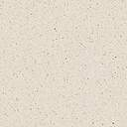
Turbidity: A measure of the scattering of light by particles in a suspension
A turbid water sample appears cloudy or “dirty”
High turbidity is the result of lots of light scattering caused by the particles in suspension
Measured in NTU (Nephelometric Turbidity Units)
lens
90° detector
lamp
180° detector
cloud
sample cell

Slide 23
EPA Turbidity regulations
For systems that use conventional* or direct filtration turbidity
always < 1 NTU
<= 0.3 NTU in at least 95 percent of the samples in any month
Systems that use other treatment must follow state limits
always < 5 NTU
WHO has similar guidelines
*Conventional means flocculation/sedimentation/filtration

Slide 24
Secondary Standards: Aesthetics
Contaminant U.S. EPA, 1993 WHO, 1984
Aluminum 0.5-0.2 mg/L 0.2 mg/L
Chloride 250 mg/L 250 mg/L
Color 15 color units 15 color units
Copper 1.0 mg/L 1.0 mg/L
Corrosivity Noncorrosive
Fluoride 2.0 mg/L
Foaming agents 0.5 mg/L
Iron 0.3 mg/L 0.3 mg/L
Manganese 0.05 mg/L 0.1 mg/L
Odor (Threshold Odor Number) 3 TON
pH 6.5-8.5 6.5-8.5
Silver 0.1 mg/L
Sulfate 250 mg/L 400 mg/L
Total dissolved solids 500 mg/L 1000 mg/L
Zinc 5.0 mg/L 5.0 mg/L
Notes:
http://water.epa.gov/drink/contaminants/index.cfm#Secondary

Slide 25

If you can only afford one treatment process
If you lived in Moroceli, Honduras and have this water source and can only afford one of these…
Flocculation and sedimentation (incorrectly referred to as pretreatment)
Filtration (incorrectly credited for all of the contaminant removal in floc/sed/filter)
Chlorination
… which do you select?
Disinfection is the last line of defense, not the first line of defense!

Slide 26
Effect of Chlorination on Inactivating Selected Bacteria
Bacteria | Cl₂ (mg/l) | Time (min) | Ct Factor (mg-min/l) | Reduction(%) | Ct for pC* of1 | Reference
Campylobacter jejuni | 0.1 | 5 | 0.5 | 99.99 | 0.125 | Blaser et al, 1986
Escherichia coli | 0.2 | 3 | 0.6 | 99.99 | 0.15 | Ram and Malley, 1984
Legionella pneumophila | 0.25 | 60-90 | 18.75 | 99 | 9.4 | Kuchta et al, 1985
Mycobacterium chelonei | 0.7 | 60 | 42 | 99.95 | 13 | Carson et al, 1978
Mycobacterium fortuitum | 1.0 | 30 | 30 | 99.4 | 13.5 | Pelletier and DuMoulin, 1987
Mycobacterium intracellulare | 0.15 | 60 | 9 | 70 | 17.2 | Pelletier and DuMoulin, 1987
Pasteurella tularensis | 0.5-1.0 | 5 | 3.75 | 99.6-100 | 1.6 | Baumann and Ludwig, 1962
Salmonella typhi | 0.5 | 6 | 3 | 99 | 1.5 | Korol et al, 1995
Shigella dysenteriae | 0.05 | 10 | 0.5 | 99.6-100 | 0.2 | Baumann and Ludwig, 1962
Staphylococcus aureus | 0.8 | 0.5 | 0.4 | 100 | -- | Bolton et al, 1988
Vibrio cholerae(smooth strain) | 1.0 | < 1 | < 1 | 100 | -- | Rice et al, 1993
Vibrio cholerae (rugose strain) | 2.0 | 30 | 60 | 99.999 | 12 | Rice et al, 1993
Yersinia enterocolitica | 1.0 | 30 | 30 | 92 | 27 | Paz et al, 1993
Small value means easy to kill!
0.15 mg/L of chlorine for 1 minute would kill 90% of E. coli!
Why is rugose so much harder to kill than smooth?
Rugose aggregate to form clumps!
Notes:
http://www.cdc.gov/safewater/about_pages/chlorinationtable.htm
I calculated the Ct for a pC* of 1. This assumes that chick’s law applies and that die off is proportional to the concentration.
0.15 mg/L of chlorine for 1 minute would kill 90% of E. coli!

Slide 27
Effect of Chlorination on Inactivating Selected Viruses
Viruses | Cl₂ (mg/l) | Time (min) | Ct factor (mg-min/l) | Reduction (%) | Ct for pC* of1 | Reference
Adenovirus | 0.2 | 40-50 sec | 0.15 | 99.8 | 0.06 | Clarke et al, 1956
Coxsackie | 0.16-0.18 | 3.8 | 0.06 | 99.6 | 0.025 | Clarke and Kabler, 1954
Hepatitis A | 0.42 | 1 | 0.42 | 99.99 | 0.105 | Grabow et al, 1983
Norwalk | 0.5-1.0 | 30 | 22.5 | -- | -- | Keswick et al, 1985
Parvovirus | 0.2 | 3.2 | 0.64 | 99 | 0.32 | Churn et al, 1984
Poliovirus | 0.5-1.0 | 30 | 22.5 | 100 | -- | Keswick et al, 1985
Rotavirus | 0.5-1.0 | 30 | 22.5 | 100 | -- | Keswick et al, 1985
Viruses are easier to inactivate than bacteria (using chlorine)
Notes:
http://www.cdc.gov/safewater/about_pages/chlorinationtable.htm
I calculated the Ct for a pC* of 1. This assumes that chick’s law applies and that die off is proportional to the concentration.

Slide 28
Effect of Chlorination on Inactivating Selected Protozoa
Protozoa | Cl₂ (mg/l) | Time (min) | Ct Factor (mg-min/l) | Reduction (%) | Ct for pC* of 1 | Reference
Cryptosporidium parvum | 80 | 90 | 7200* | 90 | 7200 | Korich et al, 1990
Entamoeba histolytica | 1.0 | 50 | 50 | 100 | -- | Snow, 1956
Giardia lamblia | -- | -- | 68-389 | 99.9 | 30 | AWWA, 1999
Naegleria fowleri | 0.5-1.0 | 60 | 45 | 99.99 | 11 | de Jonckheere and van de Voorde, 1976
How do we protect our children?
Protozoans are harder to inactivate than bacteria (using chlorine)
How many pathogens does it take to make you sick?
https://github.com/AguaClara/SWOT/wiki/Bad-Bugs
Notes:
http://www.cdc.gov/safewater/about_pages/chlorinationtable.htm
I calculated the Ct for a pC* of 1. This assumes that chick’s law applies and that die off is proportional to the concentration.

Slide 29
Which pathogens are a big concern with Chlorination?
Pathogens with a small infective dose and high resistance to chlorine
Cryptosporidium parvum
Giardia lamblia
Your choice: Which glass of water will you drink?
1 Cryptosporidium parvum (infective dose is one organism) added to 1 liter of pure water, then divided into 10 glasses
1000 Vibrio cholerae (infective dose is one million organisms) added to 1 liter of pure water, then divided into 10 glasses

Slide 30
Summary
Waterborne disease continues to be a significant public health concern especially for the majority world
Toilets (pollute the environment) and Sinks (clean our hands)
Standards for microbiological and chemical contaminants have been set by US EPA and the World Health Organization
This course is about removing these pathogens from water!

